Slide 1
SEF
User Interface Design

Slide 2
Reading
User Interface Design
Please see the Module References on the course website:
  GUI Design Essentials
  GUI Design Elements
  Another View of GUI Design
  As well as other examples and articles listed found here

Slide 3
Why are User Interfaces Important ?
User Interface Design

Slide 4
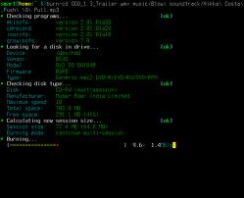
UI versus GUI – what are they ?
User Interface Design
UI – stands for User Interface
  It is the method by which an end-user is able to interact with an application of a system
  In its most raw form a UI can be a good ol’ UNIX console window or DOS window
GUI – stands for Graphical User Interface [pronounced gooey]
  In and around the late 1980’s (as more and more people began to use computers), there was a push on to evolve the UI and introduce a graphical component
  It was the idea that interacting with a system or application graphically would appeal to a wider audience and not require the end-user to have detailed computer skills or knowledge
    There have been significant strides made in the advancement of GUI’s and more recently the ideas of touch screens and gesture navigation have been added

Slide 5



UI versus GUI – more about them …
User Interface Design
Regardless of whether an interface has a graphical component or not, proper UI / GUI design is a very difficult undertaking
  There are branches of S/W Engineering and Computer Science that cross with other sciences (like Psychology) and Ergonomics to form the foundation of the study of UI/GUI Design
I’m sure that we’ve all run across many applications (both purchased or downloaded (shareware / open source) that we feel have a terrible (nasty even) UI or GUI
  But when this application is a tool or utility or game that we have purchased / downloaded for convenience or pleasure – what is the real harm ?
  But what if this poor UI / GUI forms the main interface point for a mission critical operation ?
    What if the nasty, nasty, bad interface is managing a Nuclear Power Plant ? Or is the point of interface for a pilot flying a plane ?
    Like the …

Slide 6

A-320
Cockpit
User Interface Design

Slide 7
The A-320
User Interface Design
After viewing that interface (all of the dials, panels, buttons, levers, screens, etc.) that the pilot needs to use in order to do their job …
  You might be asking yourself – how could that be made more simple ?
  The answer quite truthfully might actually be It can’t
Okay – so what’s the problem with this interface you may ask ?
  Remember that there is more to an interface (UI or GUI) than the buttons and levers …
  What about the feedback that the user receives after interacting with the interface ?
  What about the way in which the interface displays information ?
  Let’s think about that as we read the following …

Slide 8

User Interface Design

Slide 9
A Lesson learned …
User Interface Design
Although we may not ever be experts in the field of UI/GUI Design, it is our responsibility as S/W Engineers to know what components and ideas make up an effective and efficient interface
  Readability and understandability of messages
  Feedback from interaction
  Layout of the buttons, levers, textboxes … whatever is making up the GUI
  Sometimes just common sense

Slide 10
Many Approaches
User Interface Design

Slide 11
How to design the UI / GUI …
User Interface Design
There are many schools of thought around how best to approach the design of any UI/GUI
Each one of these approaches has a prescribed set of ideas / rules and best practices
No one approach is better (or achieves a better UI/GUI) than any other approach
  In fact, the best approach to take in designing a UI/GUI is to consider and explore the many ideas of each of these approaches
In this lesson, we’ll explore the approaches of
  Designing for People
  Designing for Usage
  Designing by Workflow / Window / Level of Complexity

Slide 12
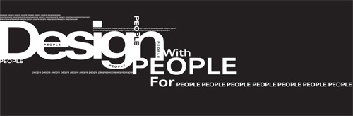
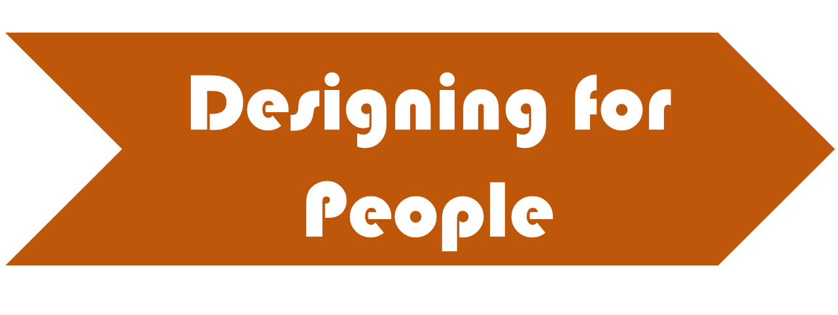
User Interface Design

Slide 13
User Interface Design
General Principles
When it comes to designing anything for people, there are 4 domains (or aspects) of the design that you need to consider
  It is important to note that these domains / aspects truly apply to any type of product targeted at being consumed / used by people
These domains / aspects are :
  Cognitive
  Visual
  Physical
  Environmental / Social
We will examine these aspects in relation to UI / GUI designs

Slide 14
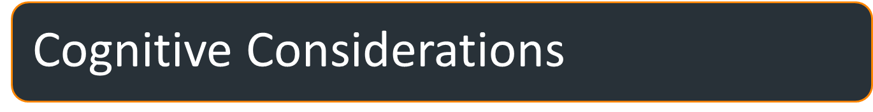
User Interface Design
These are the design considerations and design decisions that you make which
  Have to do with how people think (Cognitive Psychology)
These considerations include :
  Limiting memory load
  Breaking down decision making
  Providing context
  Being aware of the user’s mental model
  Being consistent
  Being forgiving

Slide 15

User Interface Design
Short-term memory is limited
  Both in duration and capacity
Short-term memory duration usually means what you can remember in a small number of seconds
  Typically less than 20 seconds
Short-term memory capacity means the number of things that you can remember for a short time
  Typically considered to be 7 ± 2 items
Don't make people remember more items than this for longer than this
  If your application requires a user to remember things – try to limit it to between 5 – 9 for no more than 20 seconds
  To alleviate the memory strain, UI/GUI designers often use Built-in Lists

Slide 16

User Interface Design
If your application or system requires the user to make complex decisions, or follow a decision-making process
  Then a good UI/GUI designer will break it up into smaller, more manageable parts
    Rather than presenting the user with all choices at once
  Wizards are useful for this

Slide 17

User Interface Design
A user of your application / system should never lose their place
  They should always be able to tell what area of functionality they are in
  This context can be obtained by using titles, labels, and menus effectively
    This cognitive consideration is related to helping the memory load as well

Slide 18
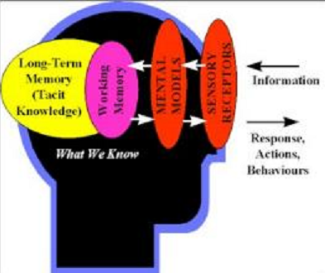
User Interface Design
A mental model is an explanation of someone’s thought process about how something works in the real world
  It is the relationships between a user’s intuition and what they do – it defines their behaviour
As users use and learn about a system, they develop expectations of its behaviour
  Try to anticipate what this mental model will be like and design appropriately
  You can even use your UI/GUI to
  shape the mental model

Slide 19
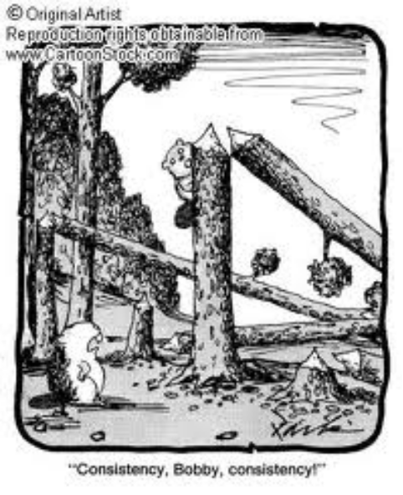
User Interface Design
If your UI/GUI
  has the user performing certain steps to achieve an action
  presents information / choices a certain way
  then always present / take these actions in the same manner
Consistency helps with a user’s understanding of the application and system

Slide 20
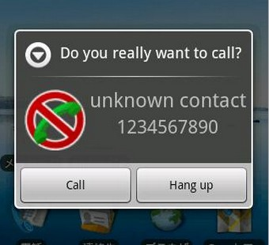
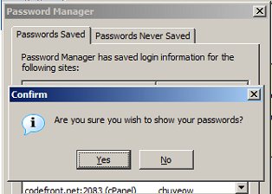
User Interface Design
Let the user explore around within the application / system without doing damage
  Allow them to make changes without being committed to them
    “Are You sure you want to do this ?”

Slide 21

User Interface Design
These are the design considerations and design decisions that you make which
  Have to do with how information will be displayed (Perceptual Psychology)
These considerations include :
  Minimizing eye movement
  Using principles of good format and layout
  Using colour and highlighting effectively
  Not assuming that people read

Slide 22

User Interface Design
When designing and laying out your UI/GUI you should strive to
  Keep information localized
  Layout the UI so that there are definite areas for user interaction (i.e. navigation area, work area, feedback area, etc.)
The general goal is that the user shouldn't have to look all over the UI/GUI in order to find what they need to do or do next.

Slide 23

User Interface Design
As a UI/GUI designer, you should always strive to follow best practices and standard layouts
  These practices, layouts and models have been proven to work
  Try to adhere to these ideas
    But at the same time, don’t be afraid to try something new – after all, that is how advancements are made – someone tries something new!
As an example of a standard - use the locale setting and accepted practices in your UI/GUI layout
    Use left-to-right / top-to-bottom flow, right-to-left / bottom-to-top, bottom-to-top / right-to-left

Slide 24

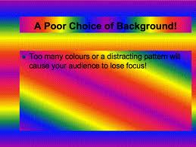
User Interface Design
The minute that we are put in charge of a UI/GUI – all of us tend to become a Picasso
  Using different font faces, different effects,
  highlighting, colour, …
All of these techniques are very useful as tools within your UI/GUI to emphasize and distinguish
  They can easily be overused and lose their impact or simply distract and confuse.

Slide 25
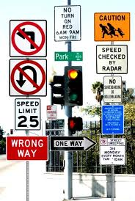
User Interface Design
Another common mistake that we make as UI/GUI designers is that we assume that user will want to and will always read everything that we include in our UI
  Don't Assume People Will Read Everything On A Screen
    Just because it's there doesn't mean that it'll be communicated
  Sometimes we create clutter in our UI/GUI with too much text …
  You may need to find other ways of communicating important information

Slide 26
User Interface Design
Physical Considerations
These are the design considerations and design decisions that you make which
  Are related to the limitations of the human body
These considerations include :
  Key Combinations
  Touch-Typing
  Input device usage(s)
  Anything Else (that doesn’t fit into the other considerations)

Slide 27
User Interface Design
In the days before more modern input devices, it was a very desirable characteristic of a UI to offer the user keyboard short-cuts
  These short-cuts were given for example as a means of navigating through an application (e.g. SHIFT-F1 takes you to the Order menu, SHIFT-F2 takes you to the Payment Menu, etc.)
    The short-cuts were often made up of a combination of individual key presses
  As the UI rules changed (and GUIs came to be) the input devices also changed
    Mouse, track-ball, pen, wand, touch-screen, gesturing, …
    This should have reduced the keyboard short-cuts – but because users had become accustomed to having these – they were still included for backwards compatibility
  Short-cuts have evolved into single key-presses within a certain context now
    So we want to remember to not overuse combined key-presses whenever possible
  And we definitely want to minimize any difficult to perform combination key-presses
    i.e. try to limit / eliminate any three (or more) simultaneous key-presses

Slide 28
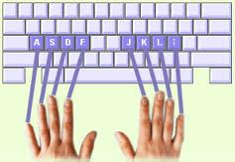
User Interface Design
Part of being a good S/W Engineer (developer or designer) is to know, understand and identify with the target users for your application / system
  For example, many people in the world practice touch-typing skills
    So therefore it would make sense while designing your UI / GUI to keep this in mind
      To make it easier for your end users to interface with your application / system
      Try to use the home row of keys as much as possible
  If you know that your typical end user will not necessarily
  be a touch typist, then choose numbers or easy-to-find letters
  and symbols
In essence, you want to know the skill set of your target user and design your UI / GUI to best suite

Slide 29

User Interface Design
Obviously the main idea behind any UI / GUI is to manage and facilitate the input of information into an application / system
  So really, you are managing the use of the various input devices
  A good rule of thumb is to try to have the user only be required to use one input device most of the time
    Avoid the 50/50 split
      i.e. for any given task, it's better to use the mouse most of the time or the keyboard most of the time
    It is okay to design a way to invoke application functionality by using multiple input devices – just don’t make it a requirement for a single activity that the user needs to use more than one device

Slide 30

User Interface Design
The Physical Considerations of UI / GUI Design also encompass some non UI/GUI specific issues
  That is, these considerations are not specific to the design of the UI/GUI but include issues around the use of the UI/GUI
    Watch out for repetitive motion syndrome
    Make sure users get training on input devices

Slide 31

User Interface Design
Environmental and Social Issues
The final idea in the approach of Designing for People is to be aware of and ensure that your design has been done with a user’s environmental and social aspects in mind :
  Like the previous Designing for Your User’s Skills idea these issues require the designer to be aware of
    The amount of stress in the user’s environment
    The basic emotional state of the user
    Building predictability into the UI/GUI
    Being aware and considering a user’s social interactions

Slide 32
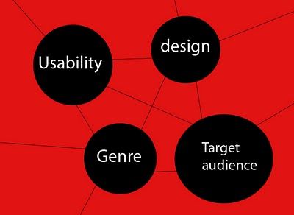
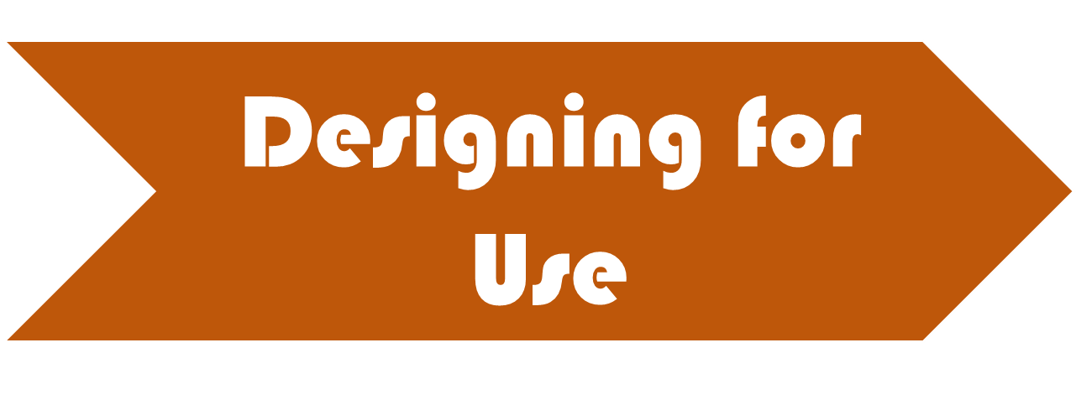
User Interface Design

Slide 33

User Interface Design
What Exactly does that mean ?
Knowing the purpose of the UI/GUI – and therefore the purpose of the application / system can be used as a design approach
    In knowing the purpose, a designer can choose from a standard set of acceptable best practices used in similar applications and system (of the same purpose)
    The danger in exclusively following this design idea is that pretty soon all UI/GUIs look the same
        BAD : No originality – a cookie cutter
        GOOD : is predictable and requires little training
Let’s examine a couple of different purposes:
  Application as a tool
  Application primarily used for searching
  Application used primarily for browsing
  Application used for purchasing / buying
  Application used for learning
  Application has an entertaining purpose

Slide 34
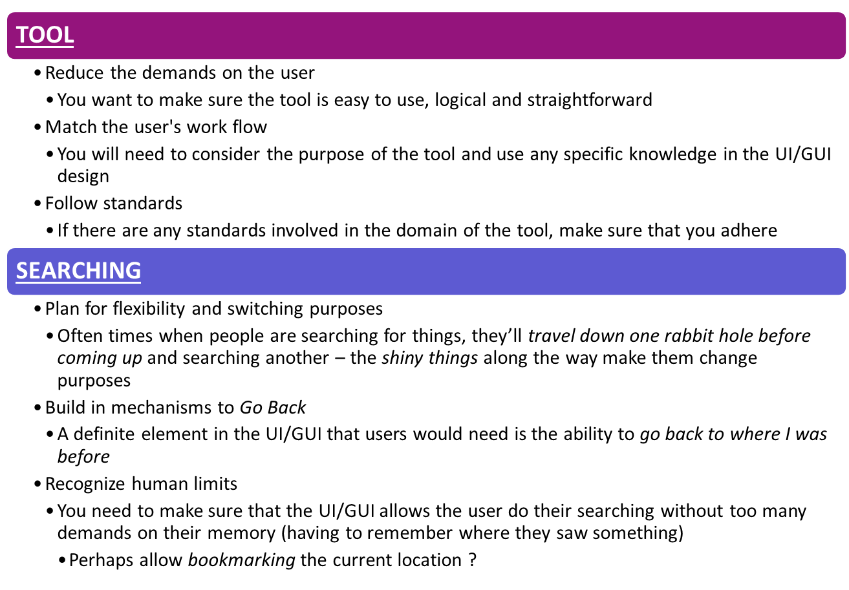


User Interface Design

Slide 35
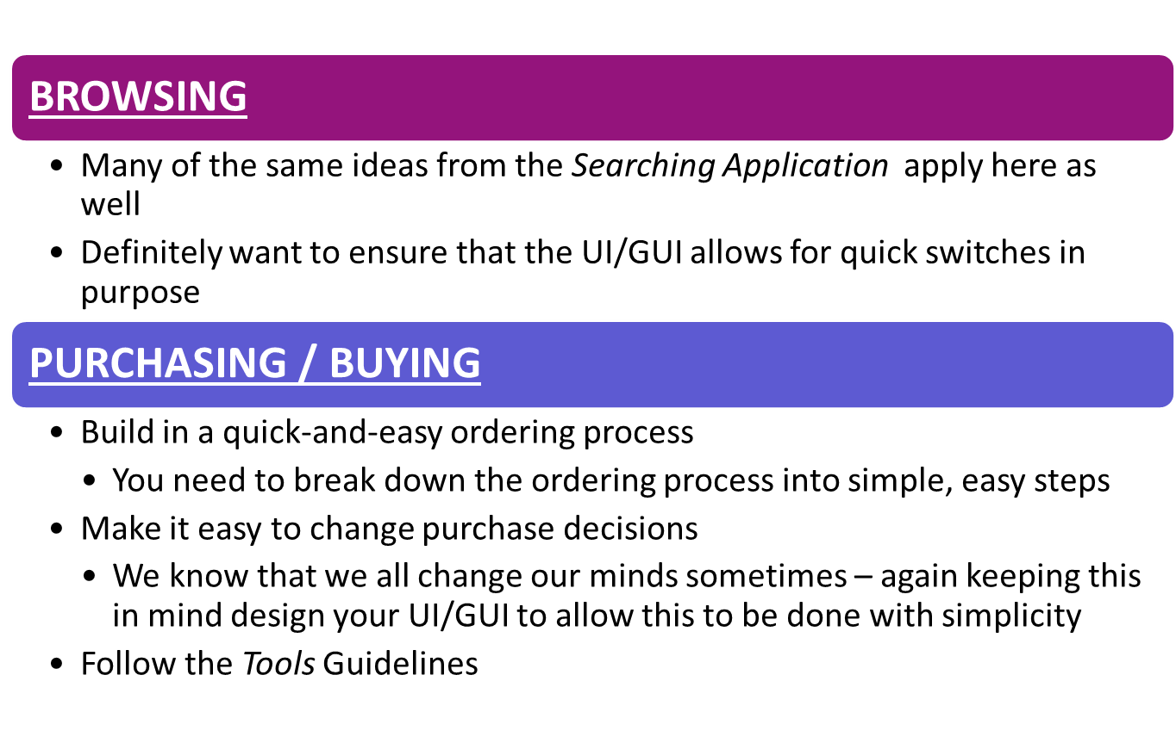

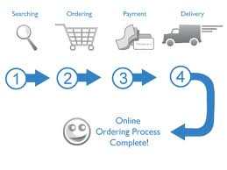
User Interface Design

Slide 36
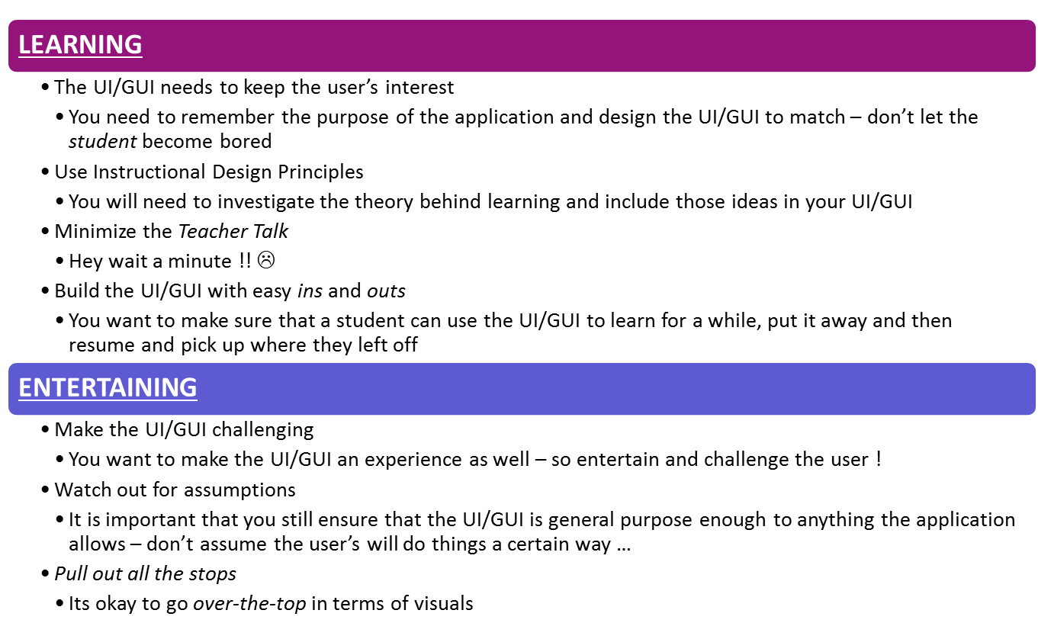


User Interface Design

Slide 37
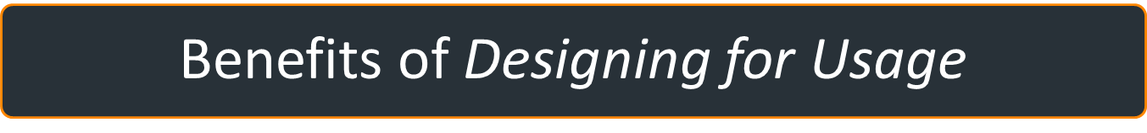
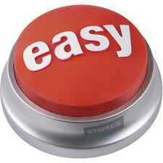
User Interface Design
If you design your UI/GUI with the application’s usage or purpose in mind there are a couple of benefits worth mentioning :
  Benefits for Users:
    Reduced work time
    Reduced training time
  Benefits to Developers:
    Reduced decision time
    Sound base for decisions involving users
    Reduced programming time

Slide 38

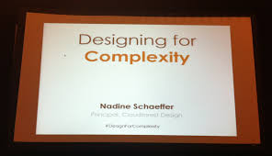

User Interface Design

Slide 39
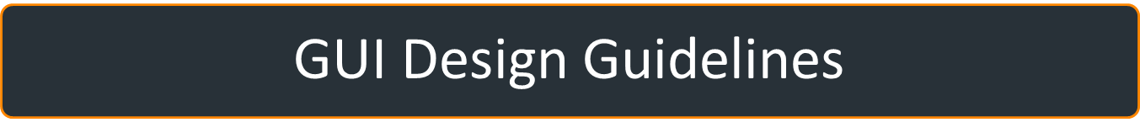
User Interface Design
This is an approach to UI/GUI design taken from Jack Harich (GUI Guru)
  He suggests that when we design and layout a UI/GUI we need to consider and try to balance three concepts
    Workflow
    Window
    Complexity

Slide 40
User Interface Design
In the design / layout of your UI/GUI you want to
  Make sure the user always knows where they are
  Ensure that it only takes a small number of clicks to get anywhere in the application
  Make sure that the high frequency windows (most commonly used) take the smallest number of clicks to get to
  Always provide useful defaults
  Always validate all user input as soon as possible
  Use wizards when needed (to guide the user through a difficult process or decision)

Slide 41
User Interface Design
In the design / layout of your UI/GUI you want to
  Make sure that the window can easily be understood (at the first glance)
  Ensure that you have followed and use any Industry Standards
  Use a standard window layout
    e.g. put most important data at upper left, buttons on bottom
  Clearly label everything
  Don't put too much on a window unless it's for a highly skilled user
  Avoid inventing cool new widgets, clever layouts, and snazzy effects
  If you provide right-click context menus, provide them everywhere
  Everything should be able to be done without the mouse
  Allow expert users to sail through a window quickly
  Always follow the principle of "least user astonishment"

Slide 42

User Interface Design
When the product has complex requirements or a complex purpose
  address the issue of making the product appear simple to the user early in the design cycle
  Hide complex areas from the casual user
    You can expose a more complex area to a user through a choice that they can make
  Provide online How To Do It assistance in a variety of levels
    Such as tool tips, F1 use, and a user's guide, …
    With each level having progressively more assistance (depending on the level of knowledge of the user)
  Make the hard stuff easy
    In some cases, provide alternate paths to accomplish something
      Using a wizard for entry level users and raw data entry for more advanced users

Slide 43
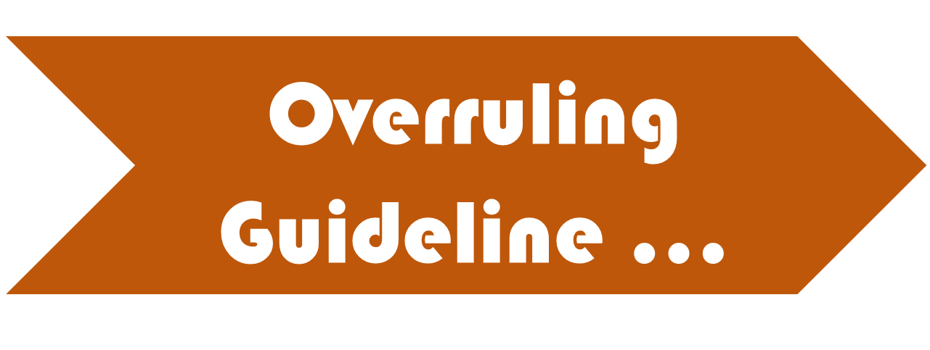
User Interface Design
    Be consistent in your UI !!

Slide 44
Example
User Interface Design

Slide 45
User Interface Design
Let’s take a quick look at how we might set about designing / laying out the UI/GUI for a windowed application …

Slide 46
Window Workflow Design Steps
User Interface Design
Determine the top objectives of the product from the user's viewpoint
  We need to know what the user expects out of this application
Organize these objectives into a single top level window
  Gather all important functionality into one window
List the window use cases (UC Descriptions)
  And rank them by frequency of use
Organize these use cases into a logical, easy to use Workflow Model
Do a paper / graphic mockup of each resulting window in the application
  By mocking the UI/GUI on paper or in a drawing program – it allows for easier change and modification
Validate the mockup model with user exercises and expert reviews
  Get feedback on your mock-ups
Fine tune the paper models with a tool such as Visio or VB (for prototypes).
Get final feedback and approval.

Slide 47
What’s the Result ?
User Interface Design
If we follow this process in the design / layout of the UI/GUI, we end up with
  A Window Workflow Model showing all windows in the application and user navigation through them
  Unambiguous definition of what each window looks like
  Textual description of what each window has and does
    And if documented with exceptions – we know how the window will handle its exceptions and alternative paths

Slide 48
Software to Prototype …
User Interface Design
There are many, many GUI prototyping software packages available
  Some of them allow you to prototype your GUI’s in both the Windows and Mobile application world
    Like Crank Software’s Storyboarder or Just-in-Mind’s Prototyper
  There are even some open-source initiatives for GUI prototyping (which are quite good) – like The Pencil Project
  Microsoft offers a set of tools called Expression Studio 4 and Expression Designer 2 which actually allow you to design your screens without caring about the code behind it – but it generates the code for you as well …
    The Microsoft Expression applications are available on the MSDNAA download website for you

Slide 49
Always Remember …
User Interface Design
There are TONS of different approaches, methods and ways of describing how to design and layout a good UI/GUI
  Different people have different opinions, based on their personal experiences
While reading the three main GUI articles, try to make note of the differences
At the end of the day – remember that everyone’s ideas can be used and you can still use your own !
  Let’s take a few moments to review some UI / GUI examples…

Slide 50
Using Prototypes in Your SRS …
User Interface Design

Slide 51
Section 2.1.2 of the SRS …
User Interface Design
From Module 2 you may recall that this section deals with the software’s User Interface …
  You may also recall that the intended audience for Section 2 are non-technical people (i.e. managers, customers, etc.)
  And what better way to allow the reader of your SRS to understand your user interface than to show them pictures (mock-ups of the various screens, button layouts, etc.) ?!?
If you already have a favourite screen mock-up / layout design tool – then please use it for your SRS …
  If you don’t – then The Pencil Project is a open-source tool and is freely downloadable
    It has also been installed on the Lab computers in 2A213 and 2A314
    Use it to mock-up your screens …

Slide 52
Take Home Assignment
User Interface Design
For October 10, 2014 …

Slide 53
Your turn to Present …
User Interface Design
Working together with a partner, come up with 2 examples of existing software or webpages that either demonstrate one of the preceding principles very well or violate it horribly
  Make sure you can discuss the examples
    Support your discussion with screenshots
    Tell us how the UI/GUI is good or bad - your reasoning needs to come from the principles in the
      Designing for People
      Designing for Usage
      Designing by Workflow, Window and Level of Complexity
  Create a single 5 minute presentation (both reviews in 1 presentation) for next class
    Before creating your presentation you might want to review the do’s and don’ts of effective presentations
  Your presentations will be marked
    Have one member of the team submit the Powerpoint presentation to the eConestoga dropbox by 11:59pm on October 9, 2014

